Slide 1

CSE 309 (Compilers)
July 2022 Term
Part II
Khaled Mahmud Shahriar
Assistant Professor
Department of CSE, BUET

Slide 2
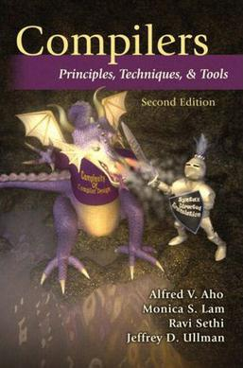
Text Book
Compilers: Principles, Techniques, and Tools (2nd Edition)
by Alfred Aho, Monica Lam, Ravi Sethi, Jeffrey Ullman
Pearson/Addison Wesley, 2007

Slide 3
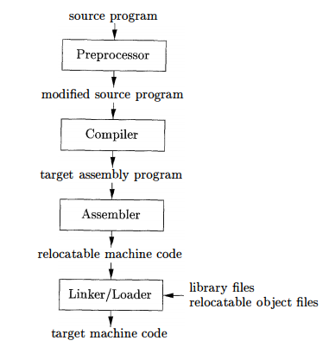
A Language Processing System
CSE 309
Recap

Slide 4
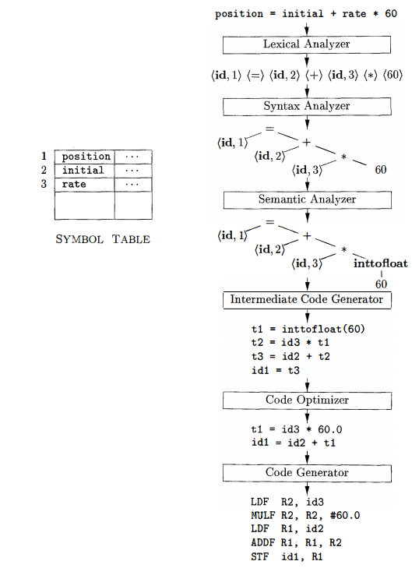
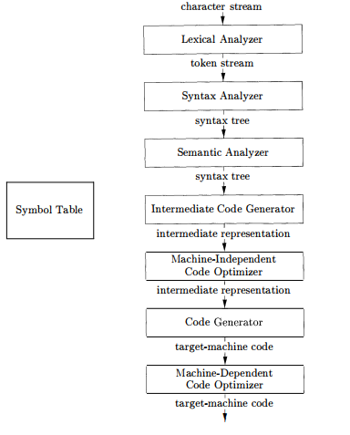
Phases of A Compiler
Analysis
(Front End)
Part I
(by MMA)
Synthesis
(Back End)
Part II
(by KMS)
Recap

Slide 5
Topics To be Covered
Syntax-Directed Translation (Chapter 5)
Intermediate-Code Generation (Chapter 6)
Runtime Environments (Chapter 7)
Code Generation (Chapter 8)
Machine-Independent Optimizations (Chapter 9)

Slide 6
Syntax Directed Translations
Chapter 5

Slide 7
Evaluate: (2+3)*4+7
E
Production
(2+3)*4
7
E → E + T
E
+
T
(2+3)*4
7
E → T
T → T * F
(2+3)
T
F
4
7
T → F
T
*
F
digit
F → ( E )
(2+3)
4
F → digit
F
digit
2+3
(
E
)
2
3
E
+
T
2
3
T
F
2
3
F
digit
2
Parse Tree
digit

Slide 8
Evaluate: (2+3)*4+7
= 27
E.val = E.val + T.val
E
E.val = E₁.val + T.val
Production
Semantic Rules
E
+
T.val=F.val
E → E + T
E.val = E₁.val + T.val
E.val=T.val
1
T
1
E → T
E.val = T.val
T.val =T.val * F.val
T
F.val=digit.lexval
F
T → T * F
T.val = T₁.val * F.val
T.val = T₁.val * F.val
1
7
T → F
T.Val = F.val
T.val=F.val
T
*
F
digit
F → ( E )
F.val = E.val
1
F.val=digit.lexval
4
digit.lexval=7
F → digit
F.val = digit.lexval
F.val=E.val
F
digit
digit.lexval=4
Add attributes to grammar symbols
Add calculation rules to productions
(
E
)
E.val = E₁.val + T.val
E.val = E.val + T.val
Syntax Directed Definition (SDD)
E.val=T.val
E
+
T
T.val=F.val
1
2
3
T.val=F.val
T
F
F.val=digit.lexval
3
2
3
F.val=digit.lexval
F
digit
digit.lexval=3
2
2
digit.lexval=2
digit
Annotated Parse Tree

Slide 9
Syntax-Directed Definitions
A context free grammar together with attributes and rules
Attributes associated with grammar symbols
Rules associated with productions
Rules calculate attributes
If a is an attribute of grammar symbol X, then X.a denotes the value of a at a particular parse tree node labeled as X.

Slide 10
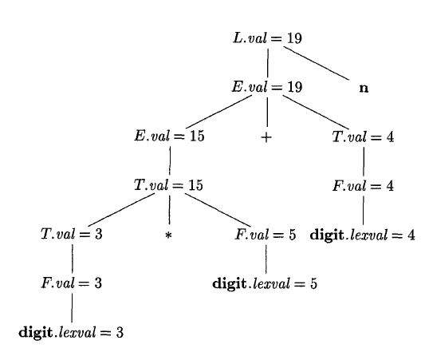
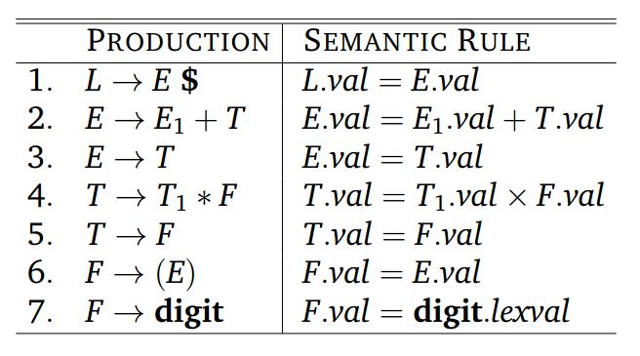
Example: SDD for desk calculator
$
What are the attributes?
val and lexval
Annotated parse tree for 3 * 5 + 4 $

Slide 11
Types of Attributes
Need to deal with two kinds of attributes for nonterminals
Synthesized Attributes
Inherited Attributes

Slide 12

Synthesized Attributes
Synthesized attributes at node N are defined only in terms of the attribute value of the children of N, and N itself
Defined at rule of N node
N
Define N.syn here

Slide 13
Inherited Attributes
Inherited attributes at node N are defined only in terms of the attribute value N’s parent, N itself and N’s siblings
Defined at rule of parent node of N node
N
Define N_{i}.inh here
N_{i}

Slide 14
Synthesized and Inherited Attributes
Synthesized attribute at node N can be defined in terms of inherited values of N
Inherited attributes at node N cannot be defined in terms of attribute values of children on N node
Terminals can have synthesized attributes only
Supplied by Scanner

Slide 15
Synthesized and Inherited Attributes
Are the attributes synthesized or inherited?
val and lexval are both synthesized

Slide 16
Some Definitions
Attribute Grammar:
SDD with no side effects i.e. no print, symbol table insertion
Define value of an attribute purely on other attributes and constants
S-attributed SDD:
All attributes are synthesized
Each rule computes attribute for head in terms of attributes of nonterminals from body

Slide 17
Some Definitions
This can be also called Attribute Grammar
And S-attributed

Slide 18
Evaluating an SDD
Suppose we have constructed a parse tree first
Attributes will be evaluated at each node
A parse tree may not be needed to be built in practice
In what order do we evaluate attributes?
For an S-attributed SDD we must evaluate in bottom-up order (like post-order traversal)
But what if there are inherited attributes also

Slide 19
Evaluate: 2*3*4
Syntax Directed Definition (SDD)
Production
Production
Semantic Rules
T → T * F
T → F T/
T/.inh = F.val, T.val=T/.syn
T → F
T / → * F T₁/
T₁/.inh = T/.inh * F.val, T/.syn = T₁/.syn
F → digit
T / → Ɛ
T/.syn = T/.inh
Eliminating Left Recursion
F → digit
F.val=digit.lexval
T.val=T/.syn
Parse Tree
T
T/.inh=F.val
T/.syn=T₁/.syn
F.val=digit.lexval
F
T/
T₁/.inh=
T/.inh *F.val
2
T₁/.syn=T₂/.syn
digit.lexval=2
digit
*
F.val=digit.lexval
F
T₁/
T₂/.inh=
T₁/.inh *F.val
3
*
F
T₂/
T₂/.syn=
T₂/.inh
digit.lexval=3
digit
F.val=digit.lexval
4
digit.lexval=4
digit
Ɛ

Slide 20
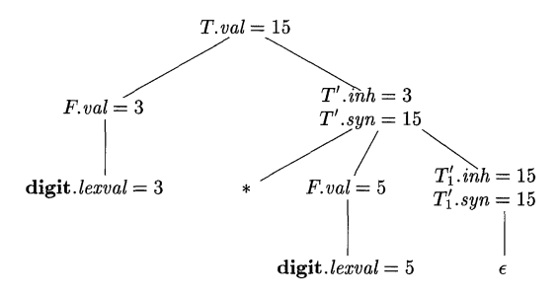
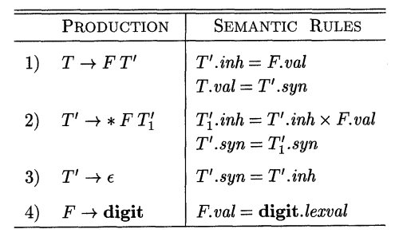
Evaluating Inherited Attributes
Annotated parse tree for 3 * 5

Slide 21
Evaluate: (2+3)*4+7
Parse Tree
Production
E
(2+3)*4
+7
E → T E/
E / → + T E /
T
E/
(2+3)
*4
E / → Ɛ
7
F
T/
+
T
E/
T → F T/
7
T / → * F T/
2+3
4
T / → Ɛ
(
E
)
*
F
T/
F
T/
Ɛ
2
+3
7
F → ( E )
4
T
E/
digit
F → digit
Ɛ
digit
Ɛ
2
3
F
T/
+
T
E/
3
2
digit
Ɛ
F
T/
Ɛ
3
digit
Ɛ
For automated parse tree generation, see: https://www.cs.princeton.edu/courses/archive/spring20/cos320/LL1/

Slide 22

Evaluate: (2+3)*4+7
Annotated Parse Tree
Production
Semantic Rules
E → T E/
E
E / → + T E /
?
E / → Ɛ
T
E/
T → F T/
F
T/
+
T
E/
T / → * F T/
T / → Ɛ
(
E
)
*
F
T/
F
T/
F → ( E )
Ɛ
4
7
F → digit
T
E/
digit
Ɛ
digit
Ɛ
T/
+
T
E/
F
2
digit
Ɛ
F
T/
Ɛ
3
digit
Ɛ

Slide 23
Evaluation Order of SDD
What is the evaluation order for the attribute instance in a given parse tree?
Useful tool:
Dependency Graph

Slide 24
Dependency Graph
Depicts flow of information among attribute instances in a particular parse tree
Nodes represent attribute instances
Nodes for all attributes at a given parse tree nodes
An edge from one attribute to another means that the first attribute is needed to compute the second
Edge represent constraint implied by semantic rule

Slide 25
Dependency Graph
Example 1:
Production Semantic Rule
E -> TF F.a=E.a+T.b
E
a
a
T
b
F

Slide 26

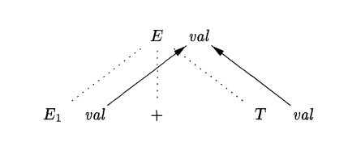
Dependency Graph
Example 2:

Slide 27
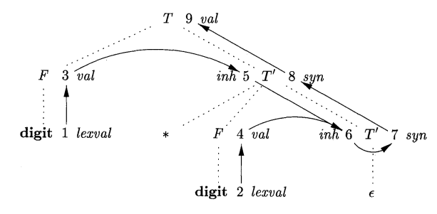
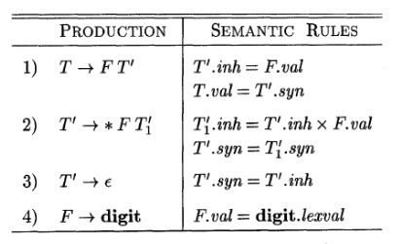
Dependency Graph
Example 3:
Dependency Graph for 1*2

Slide 28
Dependency Graph
Allowable Order : N₁, N₂, N₃,…, N_{k} such that, if there is an edge from N_{i} to N_{j} then i<j
Called Topological sort
If a directed graph is acyclic, then there is always at least one topological sort

Slide 29
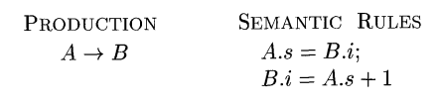
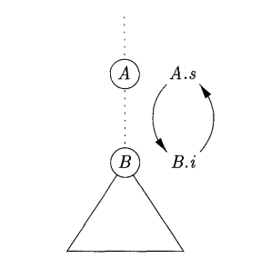
Evaluating an SDD
Not every time we will find an evaluation order
Circular dependency

Slide 30
Well Behaved SDD classes
Difficult to tell whether there exist any dependency graph with cycle
Safe way: Use classes of SDD that guarantees evaluation order
S-attributed SDD
L-attributed SDD

Slide 31
S-attributed SDD
We already know!
All attributes are synthesized
Can be calculated in bottom up order
Post Order Traversal on Parse Tree
Can be implemented during bottom-up parsing, without creating tree nodes explicitly

Slide 32
L-attributed SDD
Between attributes of a production body, dependency graph edges can go from left to right
Attributes can be
Synthesized
Inherited with some restrictions

Slide 33
L-attributed SDD
For A -> X₁X₂X₃ … X_{n}, X_{i}.a is an inherited attribute computed by a rule associated with this production
The rule may use
Inherited attribute associated with head
X_{i}.a= f(A.inh, …), where inh is an inherited attribute of A

Slide 34
L-attributed SDD
For A -> X₁X₂X₃ … X_{n}, X_{i}.a is an inherited attribute computed by a rule associated with this production
The rule may use
Either inherited or synthesized attribute associated with occurrence of X₁, X₂, X₃, … , X_{i-1}
X₅.a= f(X₂.a, X₃.b,…)

Slide 35
L-attributed SDD
For A -> X₁X₂X₃ … X_{n}, X_{i}.a is an inherited attribute computed by a rule associated with this production
The rule may use
Either inherited or synthesized attribute associated with this occurrence of X_{i}, without creating cycle
X₅.a= f(X₅.b, …)

Slide 36
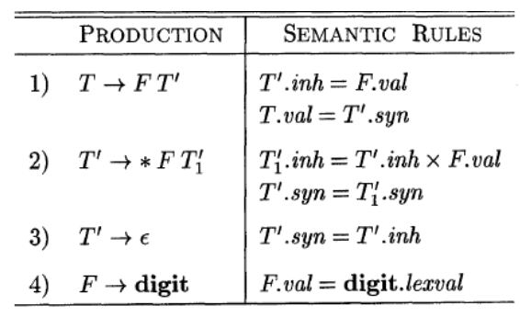
L-attributed SDD
Example of L-attributed SDD

Slide 37
L-attributed SDD
val (of both T and F), syn and lexval are synthesized

Slide 38
L-attributed SDD
inh is inherited

Slide 39
L-attributed SDD
inh is inherited
Rule 2
Rule 1 & 2

Slide 40
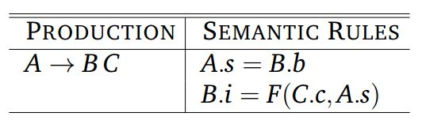
L-attributed SDD
Is the following SDD S-attributed or L-attributed?
NO! Why?

Slide 41

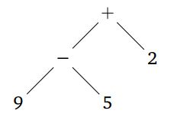
SDT Application: Construction of AST
Tree | Internal Nodes
Syntax Tree | Language Construct
Parse Tree | Non-terminals
E
E
+
E
E
-
E
2
9
5
Parse tree for 9-5+2
Abstract Syntax tree

Slide 42
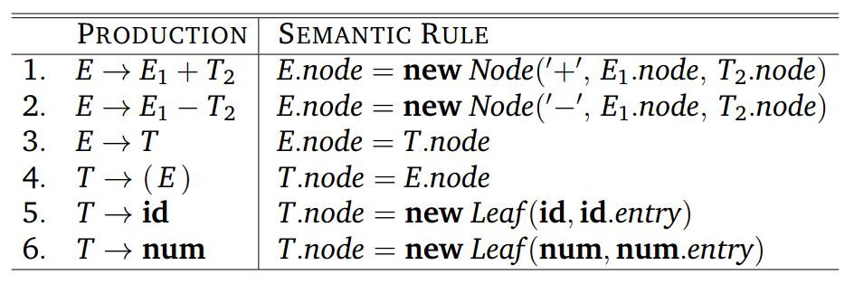
Construction of AST
Example 1: AST construction in S-attributed SDD
?

Slide 43
Construct syntax tree for: a-4+c
E
E.node = new Node (‘+’, E₁.node, T.node)
E.node = new Node (‘-’, E₁.node, T.node)
E
+
T
T.node = new Leaf (id, id.entry)
c
id
E.node = T.node
E
-
T
T.node = new Leaf (num, num.val)
4
T
num
T.node = new Leaf (id, id.entry)
a
id
+
Production
E → E₁ + T
-
id
E → E₁ - T
to entry for c
E → T
T → ( E )
num
4
id
T → id
T → num
to entry for a

Slide 44
Construction of AST
Example 1: AST construction in S-attributed SDD

Slide 45
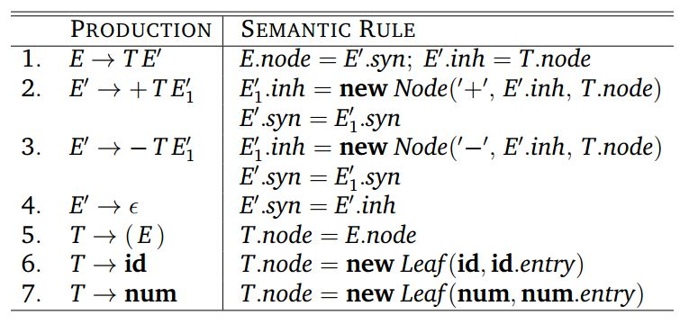
Construction of AST
Example 2: AST construction in L-attributed SDD
?

Slide 46
Construct AST for: a-4+c
E.node = E/.syn
E
E/.inh = T.node
T.node = new Leaf (id, id.entry)
E/.syn = E₁/.syn
T
E/
E₁/.inh = new Node (‘-’, E/.inh, T.node)
a
E₁/.syn = E₂/.syn
id
-
E₁/
E₂/.inh = new Node (‘+’, E₁/.inh, T.node)
T
T.node = new Leaf (num, num.val)
4
num
+
T
E₂/
E₂/.syn = E₂/.inh
T.node = new Leaf (id, id.entry)
c
+
id
Ɛ
Production
E → TE/
-
id
E/ → +TE₁/
to entry for c
E/ → -TE₁/
num
4
E/ → Ɛ
id
T → id
T → num
to entry for a

Slide 47
Construction of AST
Example 2: AST construction in L-attributed SDD
Just like we calculated value previously!

Slide 48
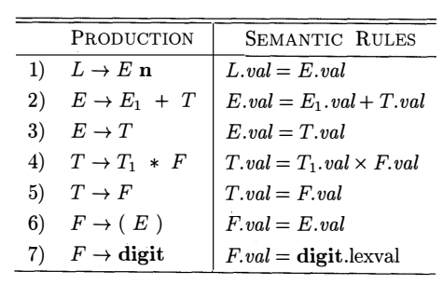
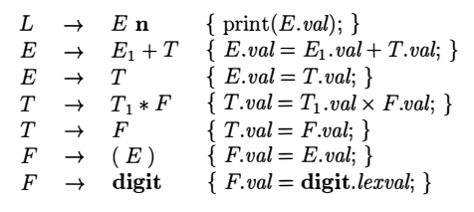
Syntax-Directed Translation Schemes (SDT)
SDD
Semantic Action
SDT

Slide 49
Syntax-Directed Translation Schemes (SDT)
Prod. | Semantic Actions
T → FT/ | T/.inh=F.val T.val=T/.syn
T/ → *FT₁/ | T₁/.inh=T/.inh x F.val T/.syn=T₁/.syn
T/ → Ɛ | T/.syn=T/.inh
F → digit | F.val=digit.lexval
SDD
SDT
T → F {T/.inh = F.val} T/{T.val = T/.syn}
T/ → *F {T₁/.inh=T/.inh x F.val} T₁/ {T/.syn=T₁/.syn}
T/ → Ɛ {T/.syn = T₁/.syn}
F → digit {F.val = digit.lexval}

Slide 50
Syntax-Directed Translation Schemes
SDT is complementary notation of SDD
SDD easier to read
SDT easier to implement
All SDD we encountered so far can be implemented using SDT
SDT is a context free grammar with program fragments (Semantic Actions) embedded in production body
Semantic Action can appear any place of production body

Slide 51
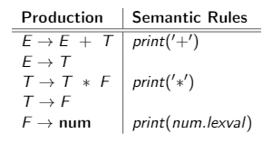
Another Example
Consider the following SDD
What this SDD do?
Convert infix expression to postfix

Slide 52
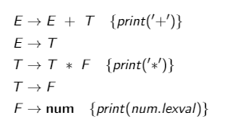
Another Example
SDD for infix to postfix conversion
SDT for infix to postfix conversion

Slide 53
Implementation of SDT
Any SDT can be implemented by building a parse tree and then performing the actions in left-right depth first order
However, typically, SDTs are implemented during parsing without explicitly constructing the parse tree
Notably, there are SDT’s that are not implementable during parsing.
Hence, we focus on two classes
CFG
+
Semantic Rules
=
SDD
LR- parsable
S-attributed
LL- parsable
L-attributed

Slide 54
Postfix SDT
SDTs with all the actions at the right ends of the production body
Postfix SDT can be constructed if the grammar can be parsed bottom up and the SDD is S-Attributed
Each action is executed along with the reduction of the body to the head of the production
Example 1
Example 2

Slide 55
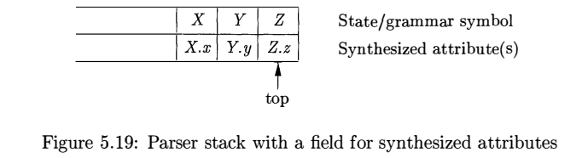
Parser-Stack Implementation of Postfix SDT
The attribute(s) of each grammar symbol can be put on the stack in a place where they can be found during reduction
The best plan is to place the attributes along with the grammar symbol (or the LR states that represent these symbols) in records on the stack itself
In example below, if we reduce by a production such as A->XYZ, then all the attributes are available at known positions of the stack
After the action, A and its attributes are at the top of the stack, in the position of record X.

Slide 56
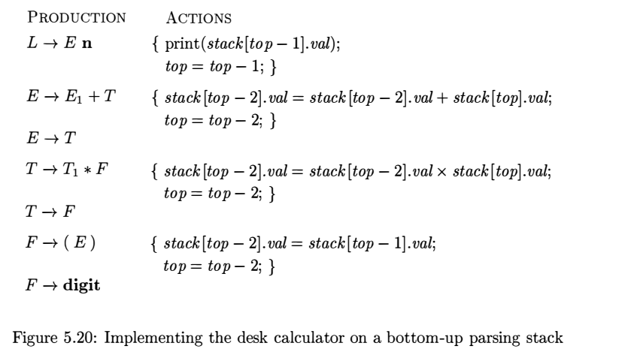
Parser-Stack Implementation of Postfix SDT
No actions, why?
No actions, why?

Slide 57
SDTs with Action Inside Procedure
An action can be places at any position of the production body
Performed immediately after all symbols to its left are processed
For B -> X {a} Y, action a is performed after recognizing X or all terminals derived from X
Bottom up parsing: As soon as X appears in the stack
Top down parsing: Before expanding Y or checking Y in input

Slide 58
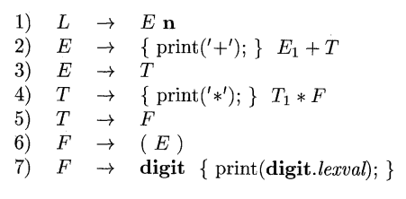
SDTs Non Implementable during Parsing
Example: Conversion to Prefix form
This example cannot be implemented during top-down or bottom up parsing
Doing critical task before knowing input
Notes:
Adding marker terminals we can convert it to postfix SDT but the grammar is not LR-parsable.

Slide 59
SDTs Non Implementable during Parsing
So, what to do with the previous SDT? Not implementable at all?
Any SDT can be implemented using:
Produce parse tree ignoring action
For each internal node, insert additional children at appropriate place representing actions if any
Perform preorder traversal and perform action at nodes corresponding to action

Slide 60
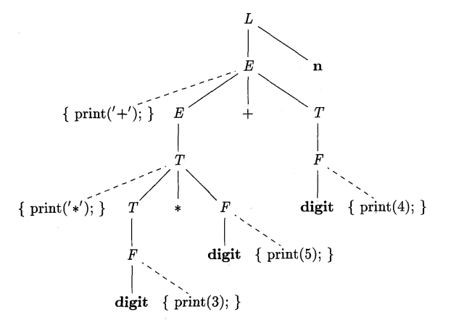
SDT Implementation using Parse Tree
Convert from infix to prefix: 3*5+4
Parse tree with action embedded
Produce parse tree ignoring action
For each internal node, insert additional children at appropriate place representing actions if any
Perform preorder traversal and perform action at nodes corresponding to action

Slide 61
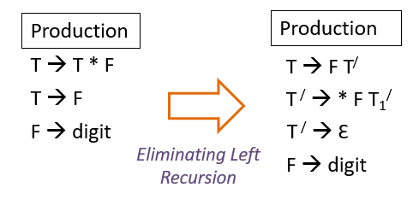
Eliminating Left Recursion
We know
What about?
T → F {T/.inh = F.val} T/{T.val = T/.syn}
T/ → *F {T₁/.inh=T/.inh x F.val} T₁/ {T/.syn=T₁/.syn}
T/ → Ɛ {T/.syn = T₁/.syn}
F → digit {F.val = digit.lexval}

Slide 62

Eliminating Left Recursion
Consider the following postfix SDT
It converts infix expression to prefix
Good with bottom-up parsing
Does it also good for top-down parsing?
No! Need to remove left recursion
With action in production body, it becomes bit tricky
Need to preserve order

Slide 63


Eliminating Left Recursion
Recap:
Grammar with left recursion
After eliminating left recursion

Slide 64
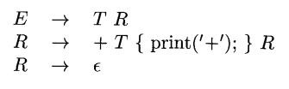
Eliminating Left Recursion
Case 1: when we only care about the order in which actions in an SDT are performed
For example, printing string
Treat the actions as if they are terminal symbols
Grammar transformation preserves the order of the terminals in the generated string
Therefore, the actions are executed in the same order in any left-to-right parse, top-down or bottom-up
α
β
SDT with left recursion
SDT without left recursion

Slide 65


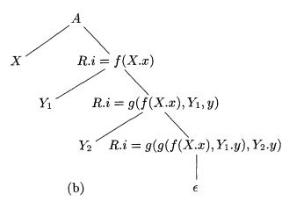
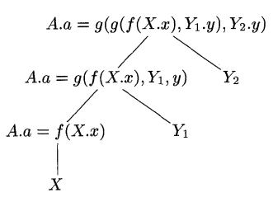
Eliminating Left Recursion
Case 2: Actions Involving Attribute Calculation
SDT with left recursion
CFG without left recursion
Annotated parse tree
Annotated parse tree

Slide 66

Eliminating Left Recursion
Case 2: Actions Involving Attribute Calculation
Annotated parse tree
Annotated parse tree
SDT with left recursion
SDT without left recursion

Slide 67
SDT for L-Attributed SDD
Rules for conversion:
Embed the action that computes the inherited attributes for a nonterminal A immediately before that occurrence of A in the body of the production.
Arrange calculation of inherited attributes of A so that dependency is maintained
Place the actions that compute a synthesized attribute for the head of a production at the end of the body of that production.

Slide 68
SDT for L-Attributed SDD
Example 1:
Prod. | Semantic Actions |  | SDT
T → FT/ | T/.inh=F.val T.val=T/.syn |  | T → F {T/.inh = F.val} T/{T.val = T/.syn}
T/ → *FT₁/ | T₁/.inh=T/.inh x F.val T/.syn=T₁/.syn |  | T/ → *F {T₁/.inh=T/.inh x F.val} T₁/ {T/.syn=T₁/.syn}
T/ → Ɛ | T/.syn=T/.inh |  | T/ → Ɛ {T/.syn = T₁/.syn}
F → digit | F.val=digit.lexval |  | F → digit {F.val = digit.lexval}
L-attributed SDD
SDT for the L-attributed SDD

Slide 69
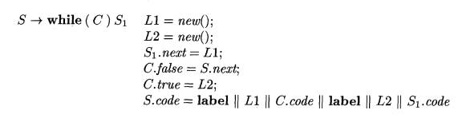
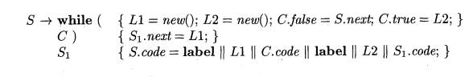
SDT for L-Attributed SDD
Example 2: SDD for while-statements
SDT

Slide 70
Implementing L-Attributed SDD
Using parse tree
Build the parse tree and annotate
First convert to SDT → build the parse tree, add actions and execute the actions in preorder
Translation during parsing
Using a recursive descent parser
Generate code on the fly
Implement SDT in conjunction with an LL-parser
Implement SDT in conjunction with an LR-parser (counter intuitive!)

Slide 71
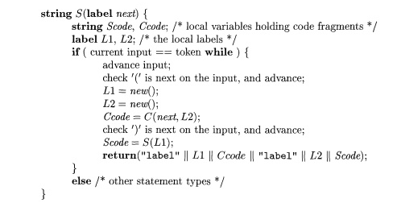
Translation During Recursive-Descent Parsing

Slide 72
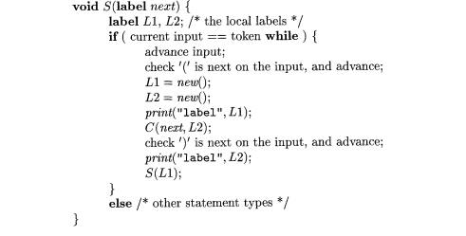
On-The-Fly Code Generation

Slide 73
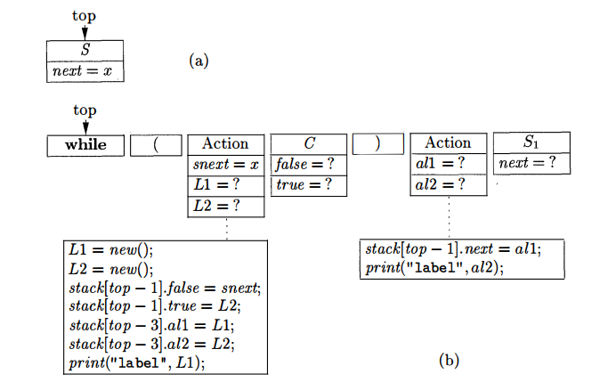
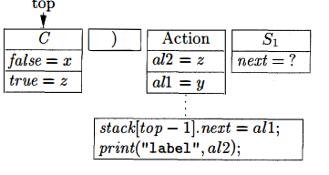
L-Attributed SDD’s and LL Parsing
Expansion of S according to the while-statement production
After the action above C is performed

Slide 74
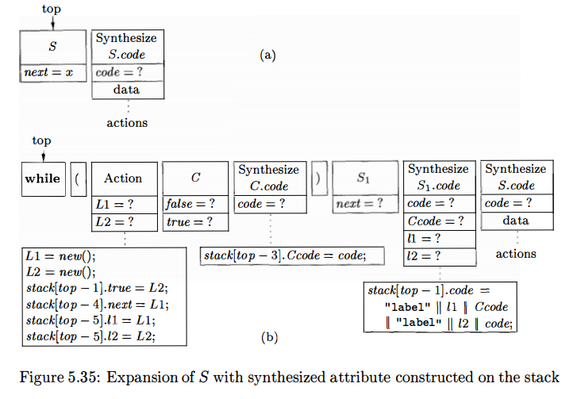
L-Attributed SDD’s and LL Parsing

Slide 75

L-Attributed SDD’s on LR Grammars
Every S-attributed SDD on an LR grammar can be implemented during a bottom-up parse.
Every L-attributed SDD on an LL grammar can be parsed top-down.
LL grammars are a proper subset of the LR grammars
S-attributed SDD's are a proper subset of the L-attributed SDD’s
Can we handle every LR grammar and L-attributed SDD bottom-up?

Slide 76
L-Attributed SDD’s on LR Grammars
Consider the production A → B C in an LR-grammar
There is an inherited attribute B.i that depends on inherited attributes of A.
When we reduce to B,
we still have not seen the input that C generates, so we cannot be sure that we have a body of production A →B C.
Thus, we cannot compute B.i yet, since we are unsure whether to use the rule associated with this production.
Perhaps we could wait until we have reduced to C, and know that we must reduce B C to A.
However, even then, we do not know the inherited attributes of A, because even after reduction, we may not be sure of the production body that contains this A.
We could reason that this decision, too, should be deferred, and therefore further defer the computation of B.i.

Slide 77
L-Attributed SDD’s on LR Grammars
If we keep reasoning this way, we soon realize that we cannot make any decisions until the entire input is parsed.
Essentially, we have reached the strategy of "build the parse tree first and then perform the translation."
However, we can do bottom up parsing of an L-attributed SDD on LL grammar

Slide 78
Reference
Compilers: Principles, Techniques, & Tools, by
Alfred B. Aho, Monica S. Lam, Ravi Sethi, Jeffrey D. Ullman
Chapter 5
5.1
5.2
5.3
5.4
5.5 (5.5.1-5.5.3)

